Slide 1
Diabetic Foot Ulcers and Diabetic Retinopathy: Prevention and Diagnosis
Geetanjali Gupta
Northeastern University

Slide 2
Table of Contents
Background Diabetes, Diabetic Foot Ulcers and Diabetic Retinopathy- Prevalence and comorbidities | 6. Summary
2. Opportunity | 7. Challenges and Limitations
3. Main Aims | 8. Recommendations
4. Diabetic Foot Ulcers Pathophysiology Clinical Workflow (rural vs urban settings) CDS Implementation Guidelines | 9. Conclusions
5. Diabetic Retinopathy Epidemiology & classification Pathophysiology Guidelines Diagnosis Clinical Workflow

Slide 3
Background: Diabetes
Diabetes is a debilitating chronic disease with significant medical and economic consequences
As of 2020, approximately 422 million people worldwide suffer from diabetes and these numbers are expected to increase to over 552 million by 2030
The economic burden of diabetes and its complications is estimated to increase to $2.1 trillion by 2030
(Brommer et al., 2018; Karakaya, & Hacisoftaoglu, 2020; World Health Organization, 2020)

Slide 4
Comorbidities of Diabetic Complications
Diabetic foot ulcers (DFUs) and diabetic retinopathy (DR) are serious and frequent complications of diabetes
DFUs and retinopathy can co-exist in diabetic patients: 41-90% of patients suffering from diabetic foot ulcers had diabetic retinopathy

Slide 5
Complications of Diabetes - DFUs
About 15-25% of diabetic patients develop foot ulcers during their lifetime, of which at least 25% don’t heal (Singh et al., 2005; Van Houtum 2005)
Treatment costs range from $3,000 to $107,900 if the wound develops additional complications and the foot requires amputation
Nearly $9B were spent on DFU treatment in 2001 alone
(Hunt, 2011; Packer et al., 2020; Sen at al., 2009; Singh et al., 2005; Van Houtum, 2005)

Slide 6
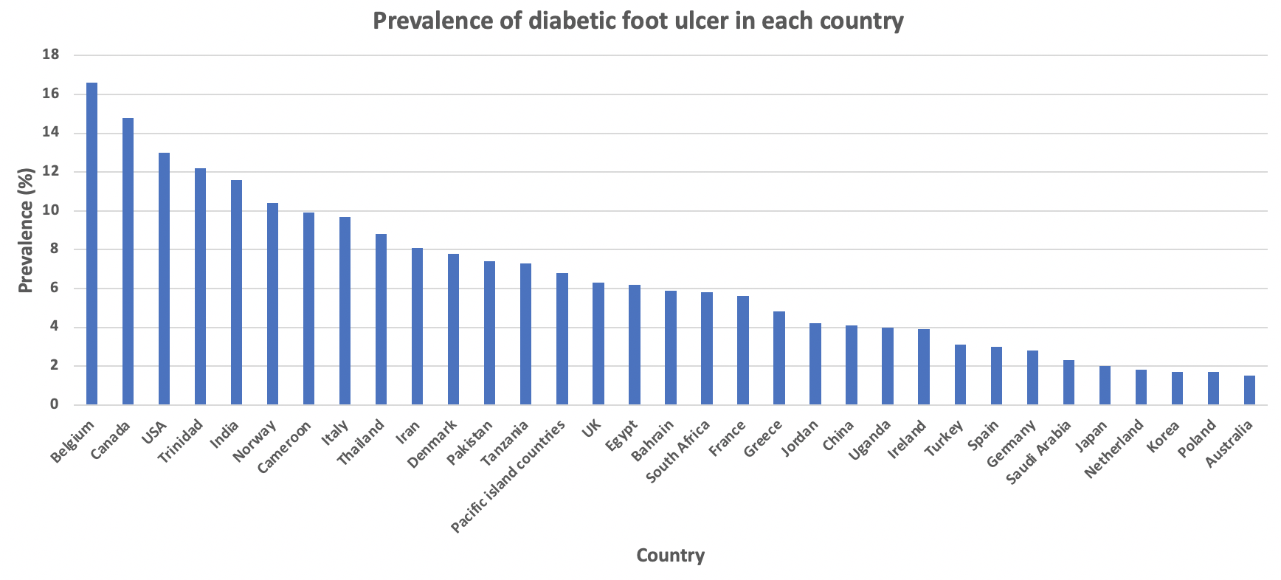
Prevalence of DFUs
DFUs are more prevalent in males and with type 2 diabetic patients
The prevalence and spectrum of diabetic foot disease vary in different regions of the world
(Zhang et al., 2017)

Slide 7
Complications of Diabetes - DR
DR is the leading cause of vision loss worldwide in individuals between the ages of 25-74 causing 12,000–24,000 new cases each year.
Most patients who develop diabetic retinopathy may have no symptoms until it has progressed to late stages (irreversible damage).
Advanced retinopathy in type 1 diabetes appears to be more common in males, and the presence and severity of diabetic retinopathy at the time of diagnosis in type 2 diabetes is also more prevalent in males.
DR accounted for an estimated $493 million of the total direct medical costs for visual disorders.
Studies have estimated that the economic burden of diabetes and its complications will increase to $2.1 trillion by 2030
(Brommer et al., 2018; Fraser & D’Amico, 2018; Ozawa et al., 2015)

Slide 8
Prevalence for DR in US
The prevalence rate for retinopathy for all adults with diabetes over 40 years of age in the United States is 28.5% (4.2 million people)
6 million Americans are projected to have diabetic retinopathy by the year 2020
(Barsegian et al., 2017)

Slide 9
Opportunity
Routine ophthalmologic screening for patients could result in saving 70,000 person-years of sight and $60-80 million annually in the United States alone with Type 1 diabetes.
Screening in patients with type 2 diabetes could save over 94,000 person-years of sight and over $250 million annually.
Even with robust systems available for screening patients, only 30% of them are screened and it is difficult to achieve the bi-annual screening recommendation by different organizations.
(Javitt, 1994)

Slide 10
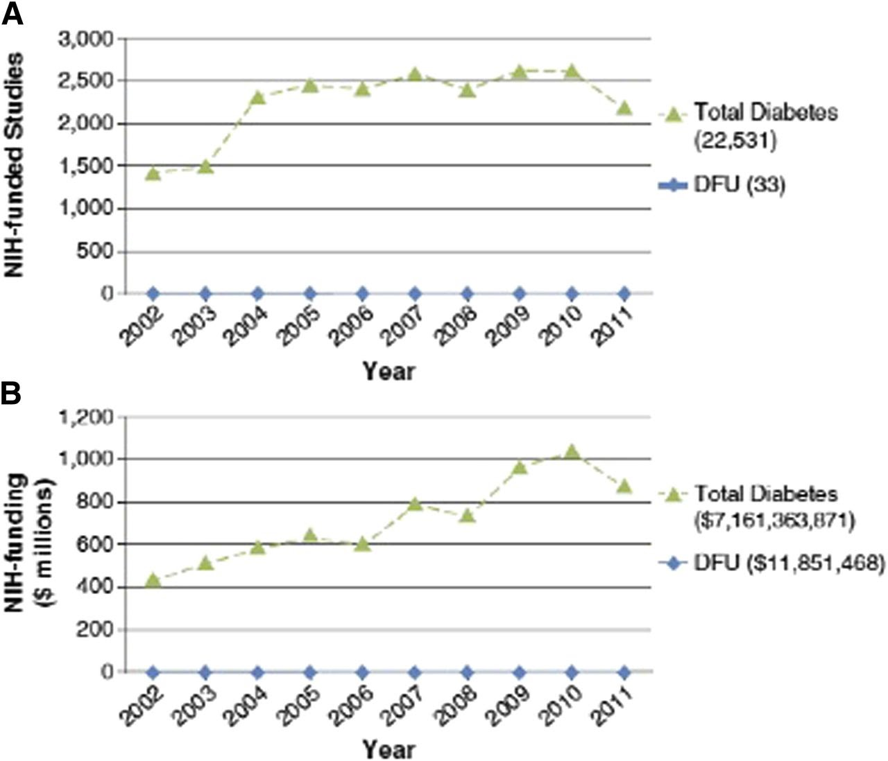
Opportunity
There is a clear need to prevent and better manage complications commonly seen in diabetic patients
Federal funding for DFU research is not proportionate to its public health impact
(Armstrong et al., 2013)

Slide 11
Main Aims
Define a clinical decision support system (CDSS) for the prevention and management of DFUs and DR
Describe how the CDSS can be used to guide clinical staff, educate patients and support shared clinical decision making

Slide 12
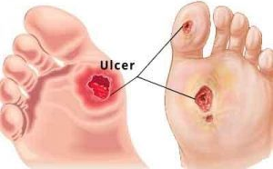
Diabetic Foot Ulcers (DFUs)

Slide 13
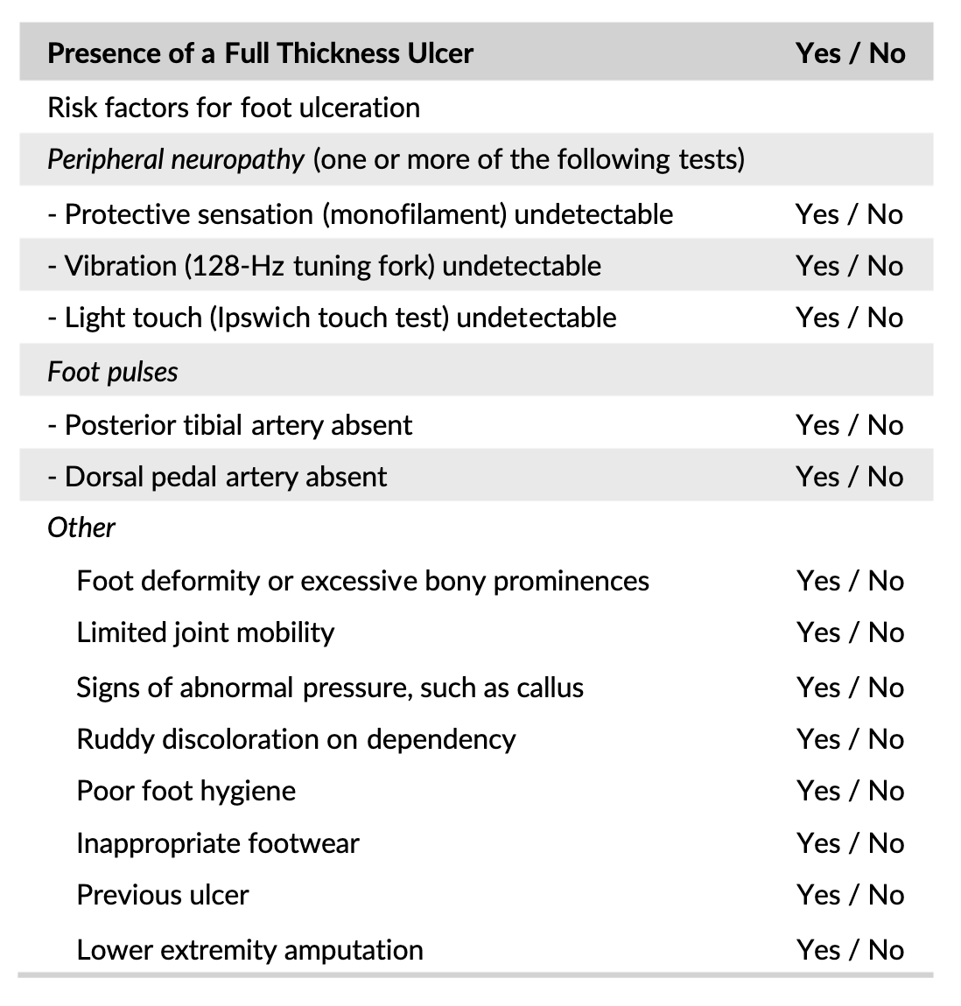
Clinical Overview on DFUs and Diabetic Neuropathy
Foot ulcers frequently occur in diabetic patients with diabetic peripheral neuropathy and peripheral artery disease.
Neuropathy leads to an insensitive and sometimes deformed foot that can easily form ulcers upon minor trauma
FU evaluation includes assessment of neurological status, vascular status, and the wound
Notes:
DFUs are a serious complication of diabetes that results from the clinical triad: (1) neuropathy (2) arterial disease (3) pressure and foot deformity

Slide 14
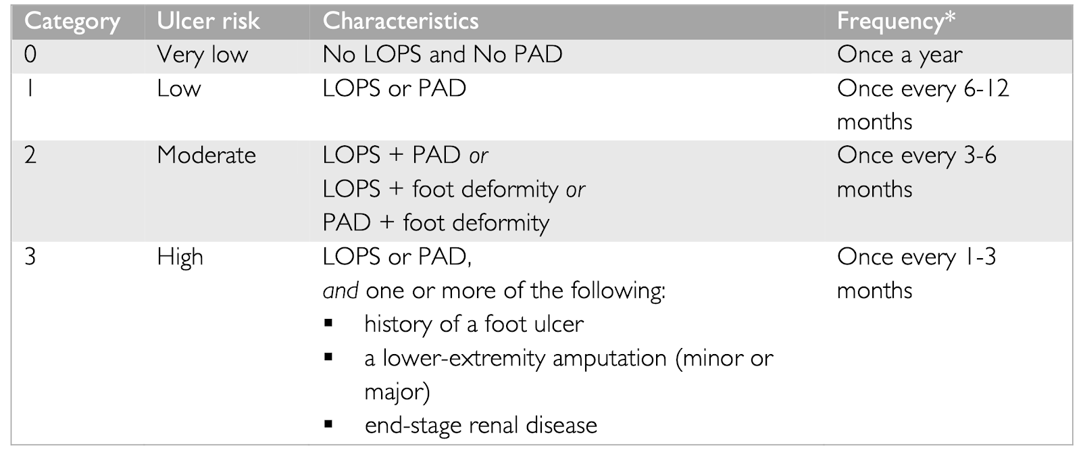
Standardized Strategies for Classifying FUs
Ulcer type: neuropathic, neuro-ischaemic, or ischaemic
Cause: examine shoes and footwear behavior of the patient (ie. wearing ill-fitted shoes)
Site and depth: debride ulcer if necessary to aid in assessment of the ulcer
Signs of infection: (1) diagnose infection by the presence of at least two signs or symptoms of inflammation or secretion (2) classify the infection using the IWGDF scheme as mild or severe

Slide 15
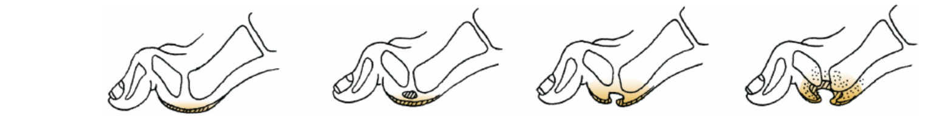
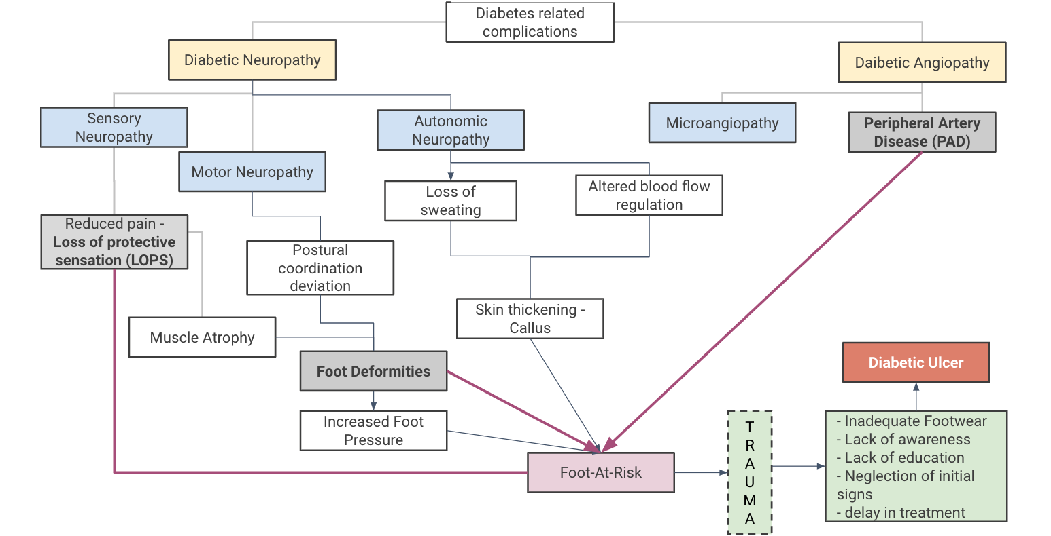
Pathophysiology of DFUs

Slide 16
Using CDS for the Prevention and Management of DFUs
Prevention of DFUs in diabetic patients requires a well-defined CDSS that is integrated with electronic health records (EHRs)
The overall goals of our CDSS design are:
Strategize prevention and management of DFUs
Maintain the medical status of diabetic patients
Provide an educational platform for the dissemination of information relevant to the patient so that they can better understand their disease and its complications

Slide 17
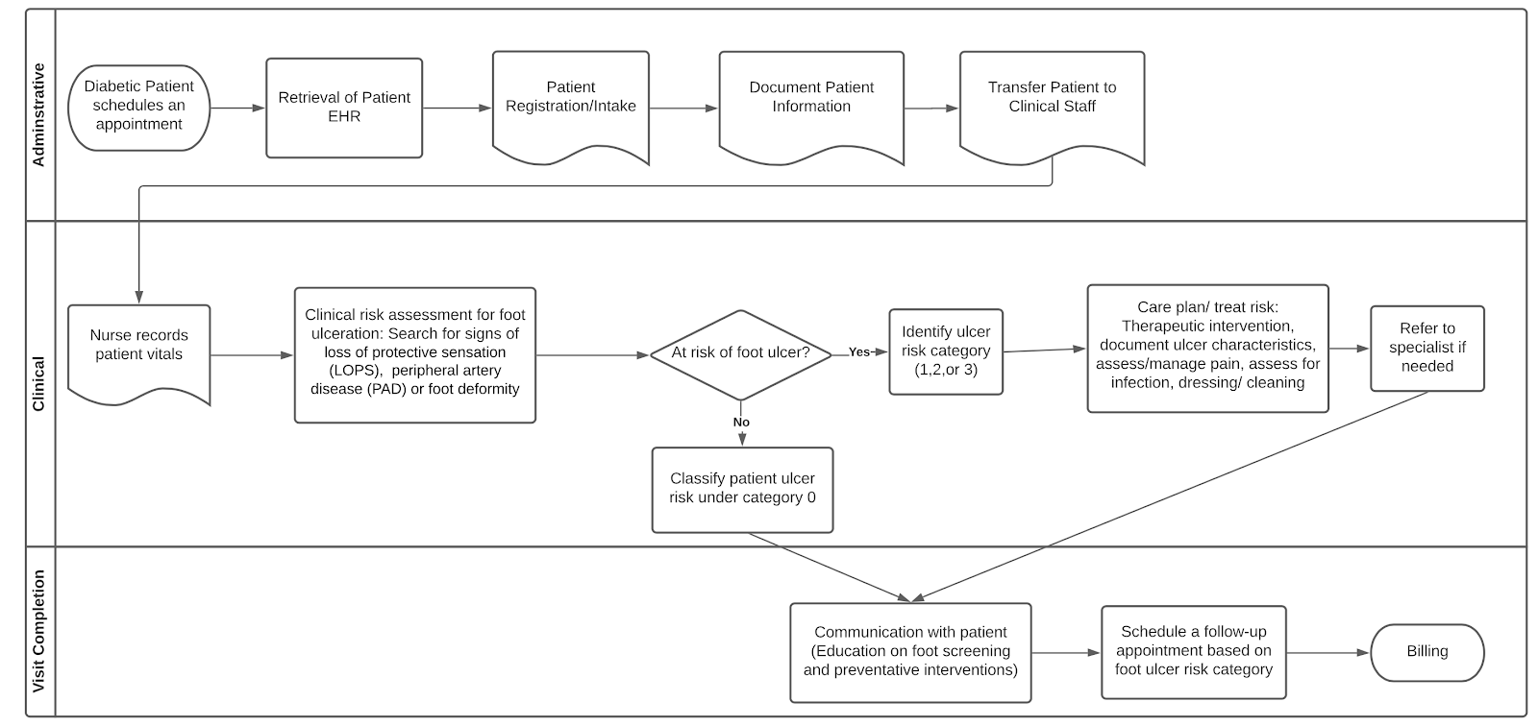
Simplified workflow for DFU patients in urban areas

Slide 18
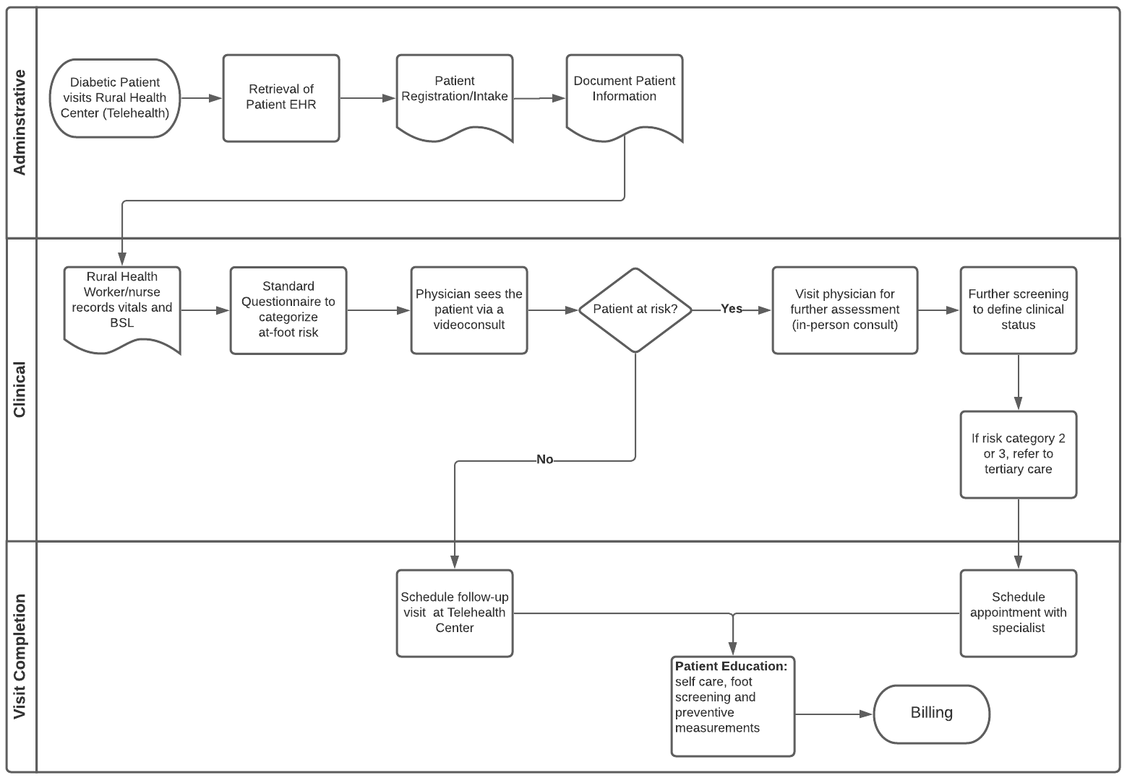
Simplified workflow for DFU patients in rural areas

Slide 19
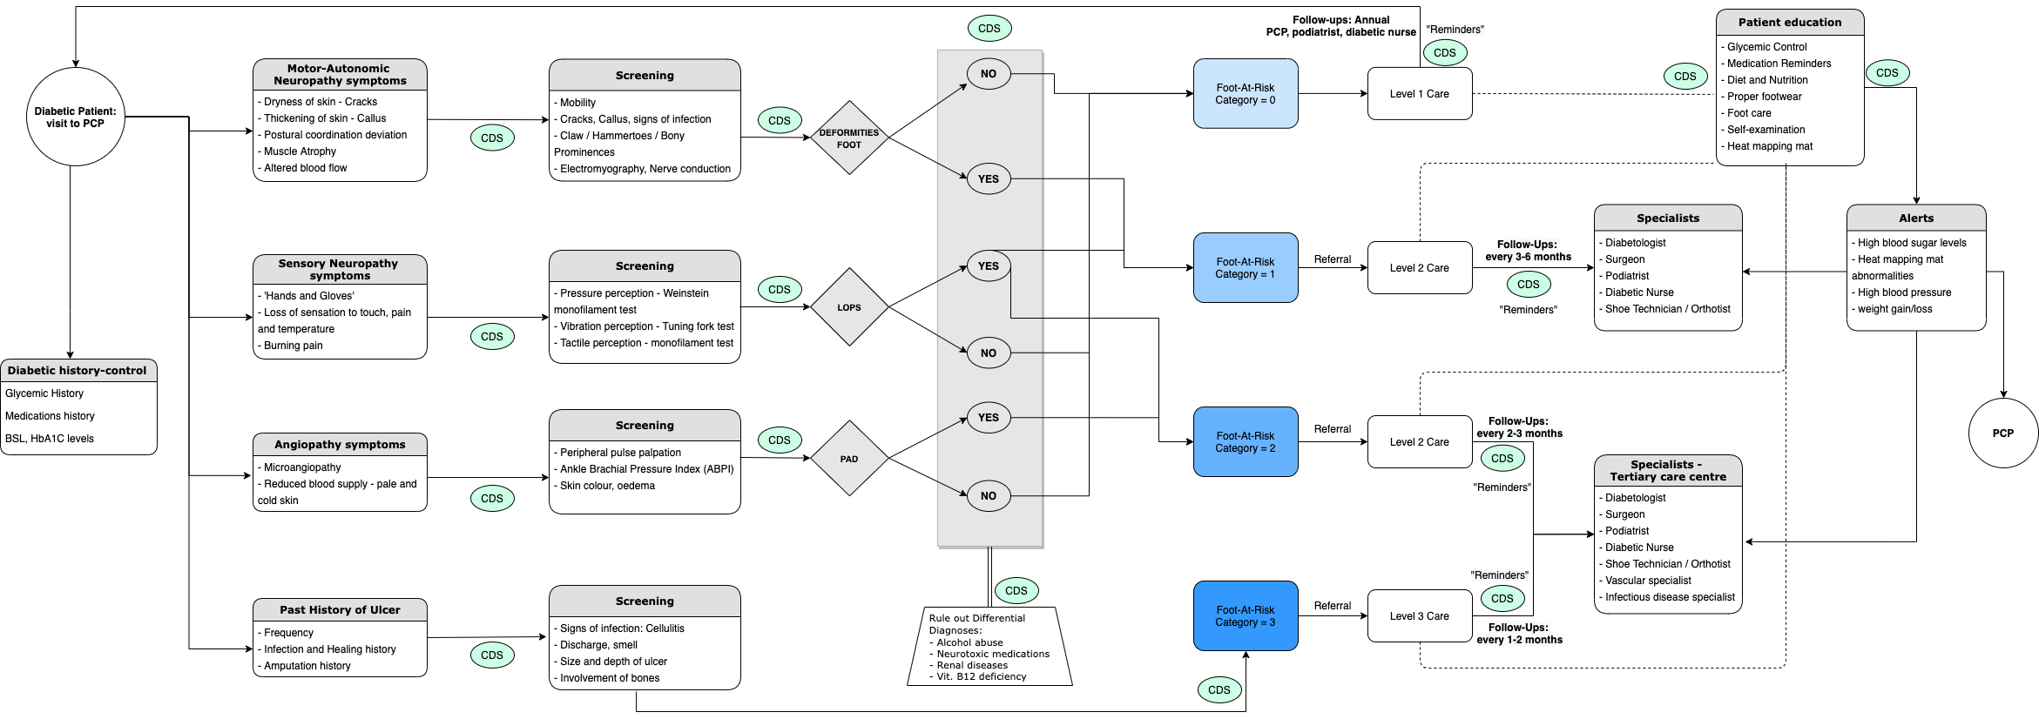
Detailed Clinical Workflow for DFUs

Slide 20
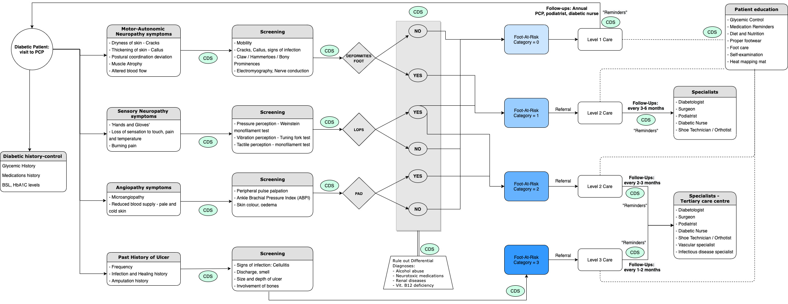
Diagnosis Workflow for DFUs
Level 1 care/ risk category 0

Slide 21
Diagnosis &
Management
Workflow for
DFUs

Slide 22
CDS Implementation in Clinical Workflows
01
Infobuttons / Knowledge Links
Retrieving relevant and up-to-date data for the clinician (i.e. guidelines and recommendations)
Printing out educational reports for patients and their families
02
Interventions
Generating automated patient reminders
Utilizing trigger events to request follow up depending on patient risk category
Alerting physicians about abnormal test results
03
Applications
EHR integration
Clinical documentation

Slide 23
CDS Modules – Data Required
Patient data:
Personal data: DOB (age), gender, address, contact details
Socio-economic data: job/profession, income, locality
Insurance data: insured (y/n), coverage
Accessibility to care: PCP, specialist
Family History: especially diabetes, w – w/o diabetic complications
Past History: recurrent infections, delayed healing of wounds
Current History: duration since diabetes diagnosed, medication, any associated chronic diseases along with diabetes
Diet: if possible, details of food intake of last 15-30 days
Clinical data & lab findings
User data:
Role/discipline – role-based access

Slide 24
Guidelines for Prevention of DFUs
Identify at-risk foot (IWGDF risk 1 or higher)
medical history, clinical evaluation (assess neurological and vascular status), foot deformities, physical limitations
Regularly inspect and examine at-risk foot
Educate the patient, family and healthcare professionals
structured, organized, culturally-appropriate and repeated education, multiple sessions, reminders/ periodic reinforcement
Ensure routine wearing of appropriate footwear
Treat risk factors for ulceration
(Schaper et al 2020)

Slide 25
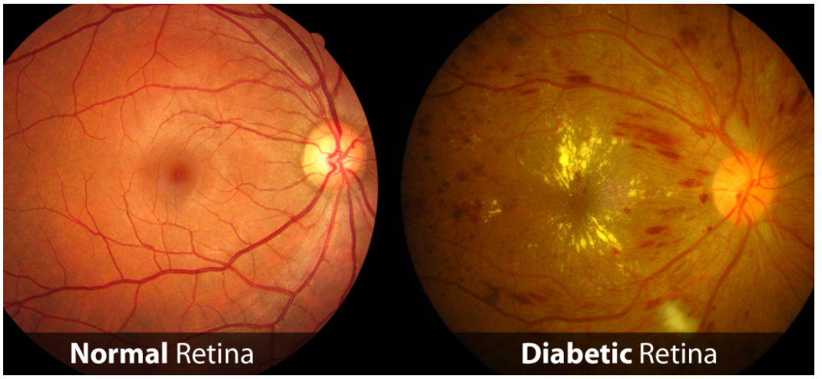
Diabetic Retinopathy (DR)

Slide 26
Epidemiology of DR
Diabetic retinopathy is the most frequent cause of new cases of blindness among adults aged 20–74 years. At some point, nearly 1 out of 3 people with diabetes has retinopathy because of damage to the blood vessels in the retina.During the first two decades of disease, nearly all patients with type 1 diabetes and >60% of patients with type 2 diabetes have retinopathy.
The prevalence of diabetic retinopathy scores >40 years of age was higher for Hispanics (36%) and African Americans (29%) than for non-Hispanic whites (22%). The difference between Hispanics and non-Hispanic whites was significant (P < 0.05).
Socioeconomic deprivation is associated with increased prevalence of DR in patients with type 1 DM than in type 2 DM.
(Barsegian et al., 2017; Low et al., 2015; Silva, 2019)
Notes:
Vision-threatening retinopathy is rare in type 1 diabetic patients in the first 3–5 years of diabetes or before puberty. During the next two decades, nearly all type 1 diabetic patients develop retinopathy. Up to 21% of patients with type 2 diabetes have retinopathy at the time of first diagnosis of diabetes, and most develop some degree of retinopathy over time..
This is significantly associated with increasing years of disease duration, A1C, systolic and diastolic blood pressure, the degree of microalbuminuria, fibrinogen, and the percentage of patients with amputations.

Slide 27
Risk Factors for DR
Chronic hyperglycemia
Hypertension
Hyperlipidemia
Pregnancy
Small vessel complications like neuropathy and nephropathy
Obesity
Puberty in Type I diabetics
(Fraser et al., 2019; Ogunyemi & Kermah, 2015)

Slide 28
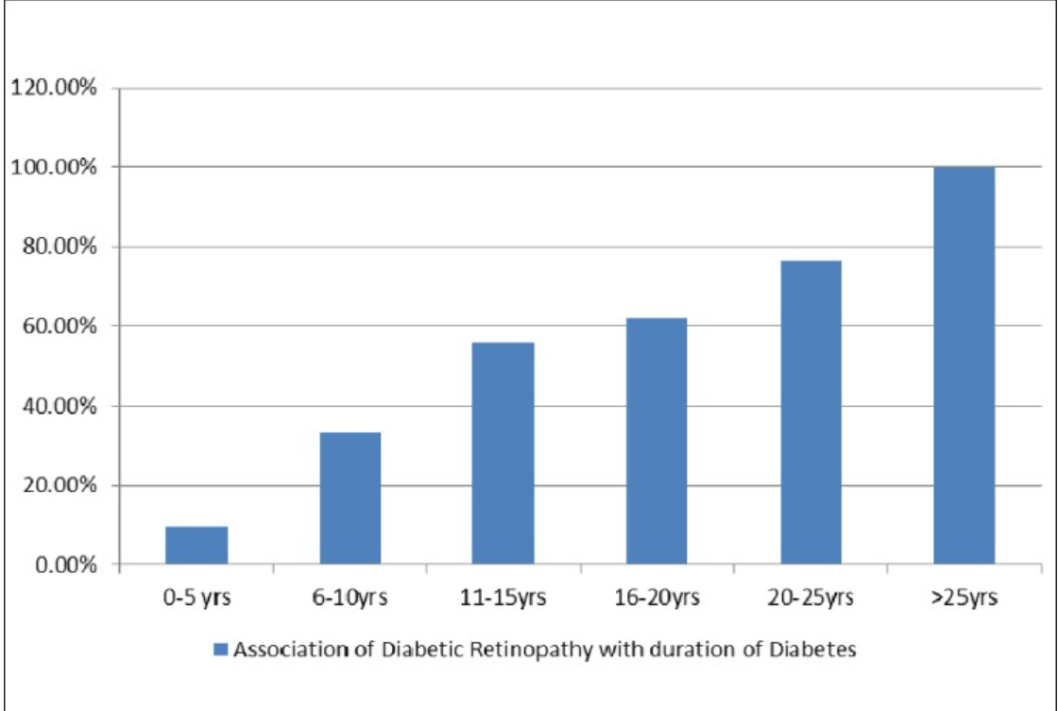
Duration of Diabetes and DR
(Gupta et al., 2013)

Slide 29
Pathophysiology of Diabetic Retinopathy
Characterized by vascular abnormalities in the retina
Two major changes in the retinal vessels
Occlusion and ischemia, leading to neovascularization
Abnormal permeability
Usually no symptoms until the late stages
transient loss of vision, floaters, flashes of light, progressive loss of visual acuity, image distortion, defects in the visual field
Divided into two stages: proliferative (PDR) and non-proliferative (NPDR)
(American International Medical University, 2017; Fraser, & D’Amico, 2018)

Slide 30
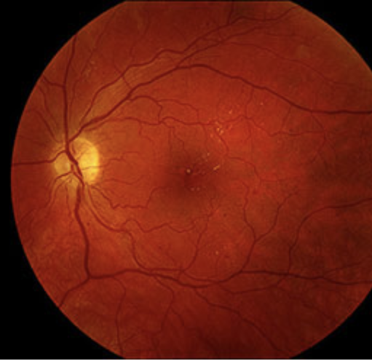
NPDR
More common
Early stages
Mild symptoms or none at all
Tissue death of nerve fibers
Intraretinal hemorrhages
Vessel occlusions
Microaneurysms
Dilated or twisted vessels
Vision loss at this stage usually due to macular edema
NPDR with microaneurysms and exudate
(Fraser, & D’Amico, 2018)

Slide 31
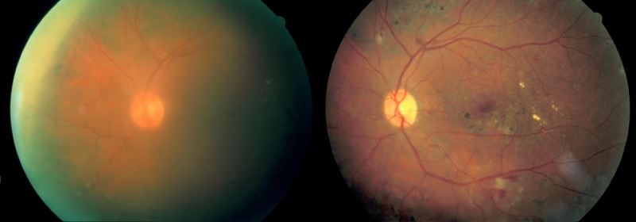
PDR
Neovascularization of retinal vessels, disc, or both
Preretinal hemorrhage
Vitreous hemorrhage
Vitreous fibrosis
Retinal detachment
Vision loss at this stage usually due to leakage of blood into the retina, can be transient
Permanent vision loss at this stage usually caused by retinal detachment and/or macular edema
Left: moderate vitreous hemorrhage, Right: 1 year later after spontaneous clearing of the hemorrhage
(Fraser, & D’Amico, 2018)

Slide 32
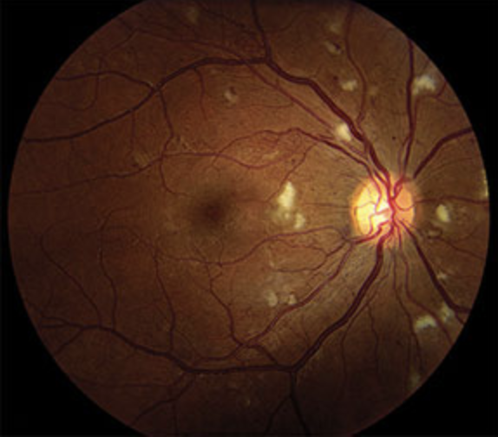
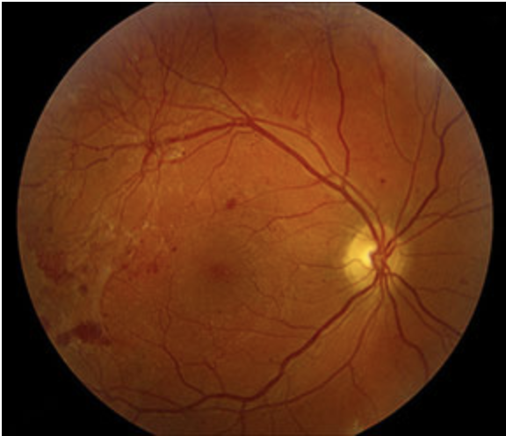
Severity Classification
NDPR
Mild
Moderate
Severe
Very severe
PDR
Early
High risk
Severe
Severe NPDR with cotton-wool spots,
intraretinal hemorrhage and IRMAs
PDR with neovascularization and
vitreous hemorrhage
(Fraser, & D’Amico, 2018)

Slide 33
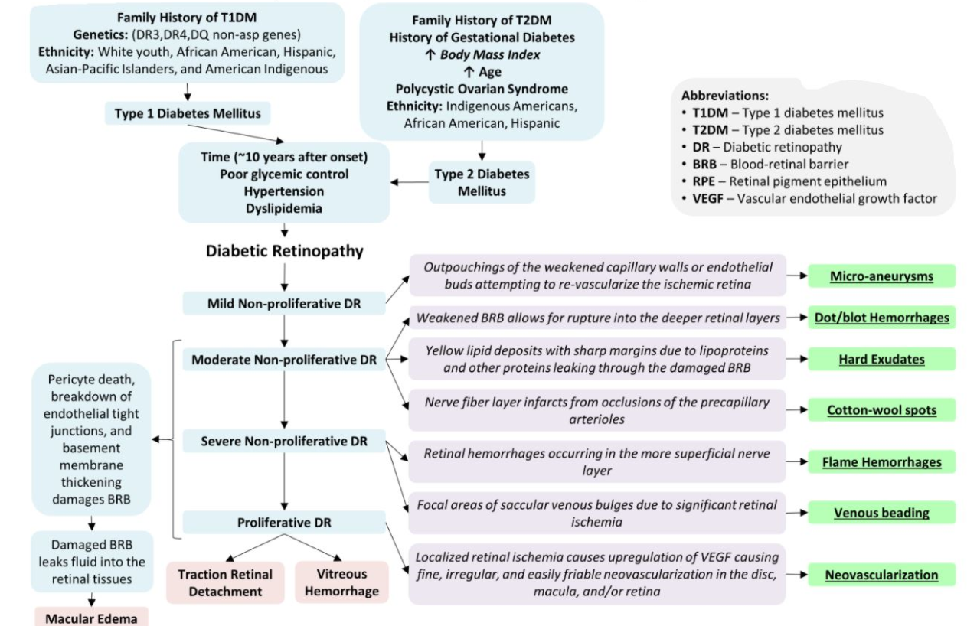
Pathophysiology of Diabetic Retinopathy
(Diabetic Retinopathy: Pathogenesis and Clinical Findings Mild ... | GrepMed, n.d.)

Slide 34
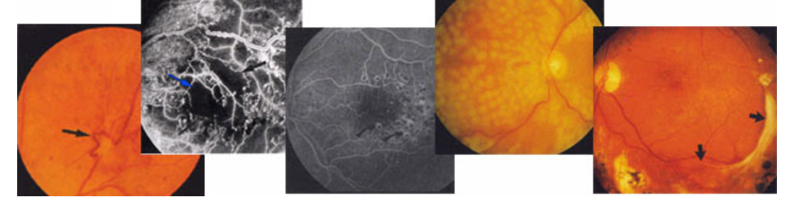
Diabetic Retinopathy (DR)
Guidelines

Slide 35
American Diabetes Association Ophthalmologic Examination Schedule for Diabetic Retinopathy
Patient Group | Recommended First Examination | Minimum Routine Follow-up
Type I Diabetes | Within 5 years after diagnosis of Diabetes when patient is age 10 years or older | Yearly, if retinopathy present. Every 2 years if there is no evidence of retinopathy
Type II Diabetes | At time of Diagnosis of Diabetes | Yearly, if retinopathy present. Every 2 years if there is no evidence of retinopathy
Pregnancy in pre-existing Diabetes | Prior to conception and during first trimester. | Close follow-up throughout pregnancy and for 1 year postpartum.
(McCulloch, 2020)

Slide 36
American Diabetes Association General Guidelines
Optimize glycemic control to reduce the risk or slow the progression of diabetic retinopathy.
Optimize blood pressure and serum lipid control to reduce the risk or slow the progression of diabetic retinopathy.
Adults with type 1 diabetes should have an initial dilated and comprehensive eye examination by an ophthalmologist or optometrist within 5 years after the onset of diabetes.
Patients with type 2 diabetes should have an initial dilated and comprehensive eye examination by an ophthalmologist or optometrist at the time of the diabetes diagnosis.
(Wong et al., 2018)

Slide 37
American Diabetes Association General Guidelines
If there is no evidence of retinopathy for one or more annual eye exams and glycemia is well controlled, then exams every 1-2 years may be considered; if any level of diabetic retinopathy is present, subsequent dilated retinal examinations should be repeated at least annually by an ophthalmologist or optometrist; if retinopathy is progressing or sight-threatening, then examinations will be required more frequently.
While retinal photography may serve as a screening tool for retinopathy, it is not a substitute for a comprehensive eye exam.
Women with preexisting type 1 or type 2 diabetes who are planning pregnancy or who are pregnant should be counseled on the risk of development and/or progression of diabetic retinopathy
(Wong et al., 2018)

Slide 38
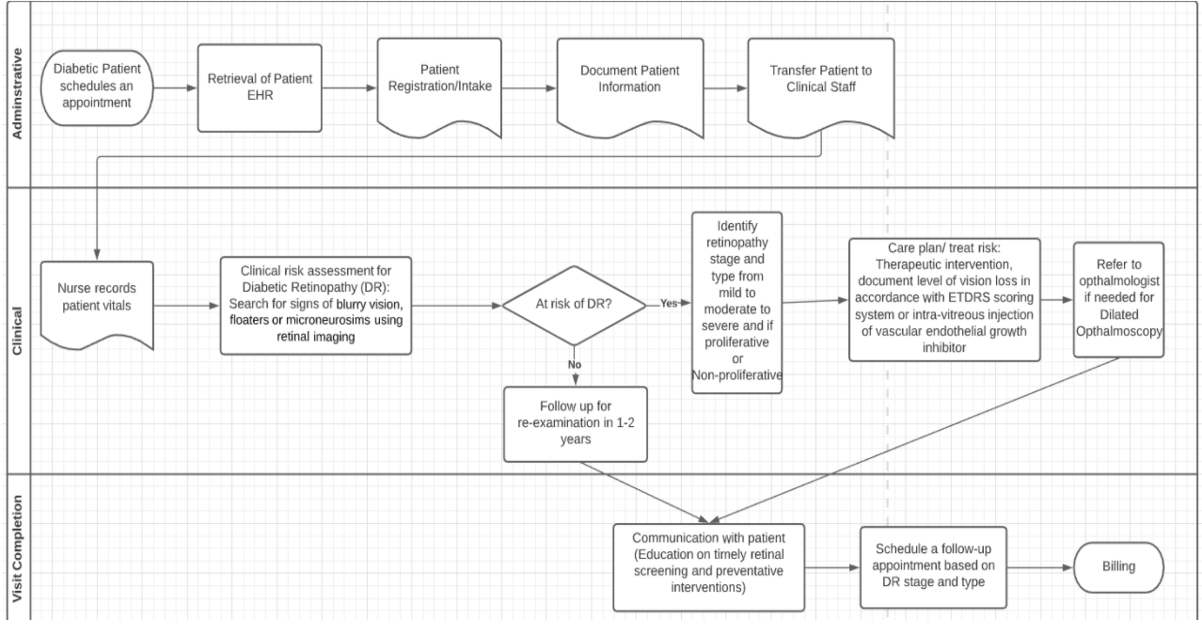
Diabetic Retinopathy Clinical Workflow

Slide 39
Diagnosis
Diagnostic Gold Standard - Ophthalmoscopy
The process of assessing the dilated fundus and structures of the eye using an ophthalmoscope
Should be performed by a ophthalmologist or optometrist experienced in diagnosing diabetic retinopathy
When performed by a primary care physician - diagnostic accuracy is substantially reduced
(McCulloch, 2020)

Slide 40
Diagnosis
Half of the diabetic patients in the US alone do not receive the recommended screening
Diagnostic gold standard is hard to achieve
Lack of specialty providers in rural areas
Lack of specialty providers within the primary care setting
Barriers to annual screening
lack of insurance eligibility
medical comorbidities
social isolation
fear
depression
social determinants of health
The primary care setting may be the only encounter for many patients that can present an opportunity to screen for DR
(Cuadros, 2020)

Slide 41
Diagnosis
What to do when the gold standard cannot be met?
Literature does support other diagnostic and screening measures
Digital stereoscopic retinal imaging
86% agreement between the use of ophthalmoscopy and retinal imaging in diagnosing diabetic retinopathy
Can be interpreted in different ways depending on the resources available
Ophthalmologist or optometrist on site
Telehealth - remote interpretation
Computerized algorithm
(McCulloch, 2020)

Slide 42
Prevention of Diabetic Retinopathy
Identification of at-risk patients
Evaluation of patient knowledge
Adherence to screening guidelines

Slide 43
CDS Implementation in Clinical Workflows
01
Infobuttons / Knowledge Links
Retrieving relevant and up-to-date data for clinician (i.e. guidelines and recommendations)
Printing out educational reports for patients and their families
02
Interventions
Generating automated patient reminders
Utilizing trigger events to request follow up depending on patient risk category
Alerting physicians about abnormal test results
03
Applications
EHR integration
Clinical documentation

Slide 44
Required Data for CDS Implementation
Patient Data
Diagnosis of diabetes (new or historical)
duration of diagnosis, prior complications, associated conditions
Patient demographics
Age, gender, race/ethnicity, address, contact information
Social determinants of health
Access to healthcare, access to primary healthcare, health literacy, employment/income, socioeconomic conditions
Pregnancy status: family planning, female of childbearing age?
Insurance status: coverage, specialty provider coverage, copay information
Laboratory/clinical values
Glycemic control
Blood pressure control
Lipid panel

Slide 45
CDS: Trigger Events
Presence or addition of a diagnosis of diabetes
First trigger of the CDS
Duration since last screening or examination (based on guidelines)
If there is a prior screening or examination
Results of initial screening
Results of prior screening
Results of follow-up examinations
Adherence to follow-up and referrals

Slide 46
CDS: Impacted Applications
Order entry
Prompts for recommended screening tests
Follow-up scheduling
CDS to provide prompts for follow-up intervals
Referral process
CDS to provide prompts for referrals to specialty providers
Provide patient resources specific to local areas

Slide 47
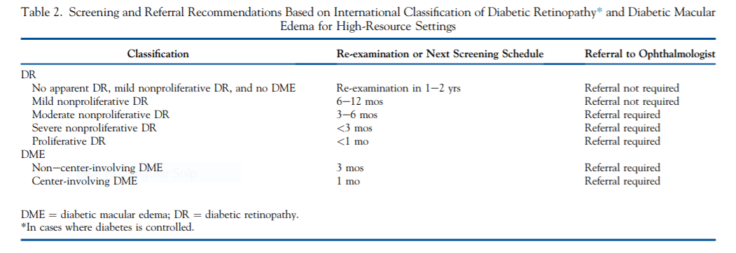
Screening Schedule: High Resource Settings
(Wong et al., 2018)

Slide 48
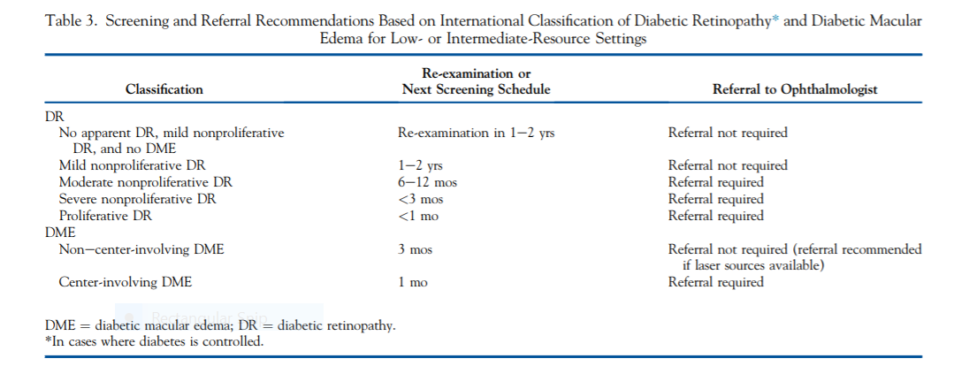
Screening Schedule: Low-Intermediate Resource Settings
(Wong et al., 2018)

Slide 49
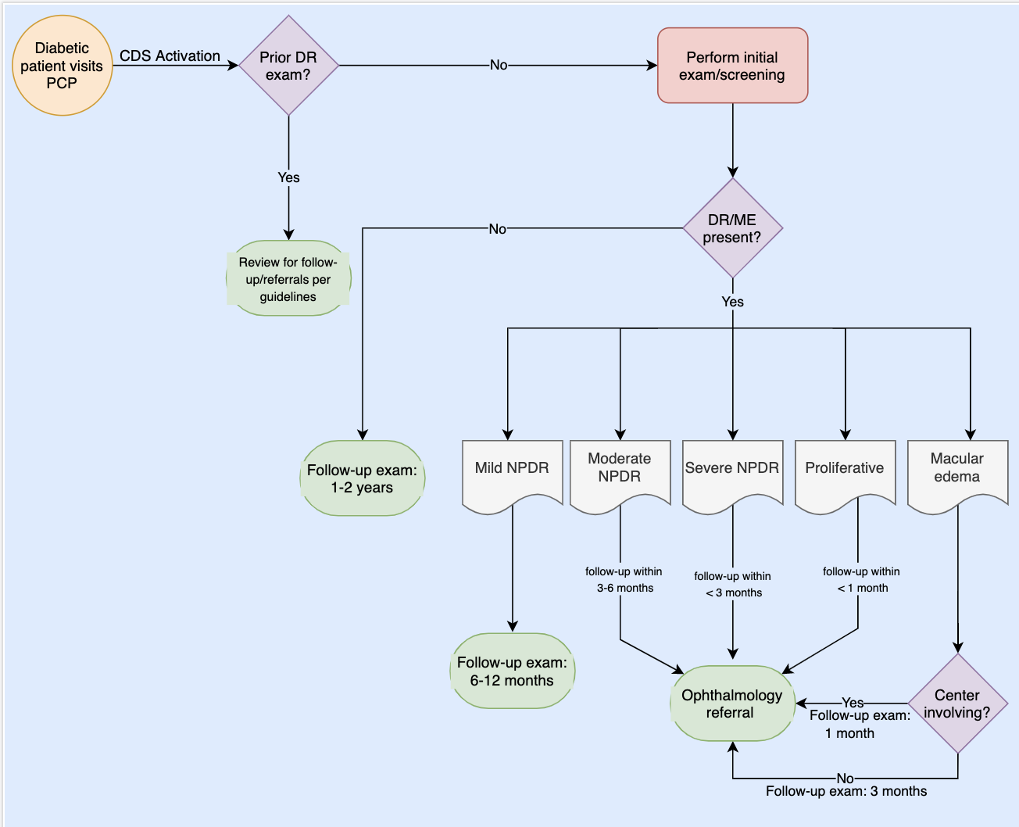
CDS Implementation: High Resource Settings

Slide 50
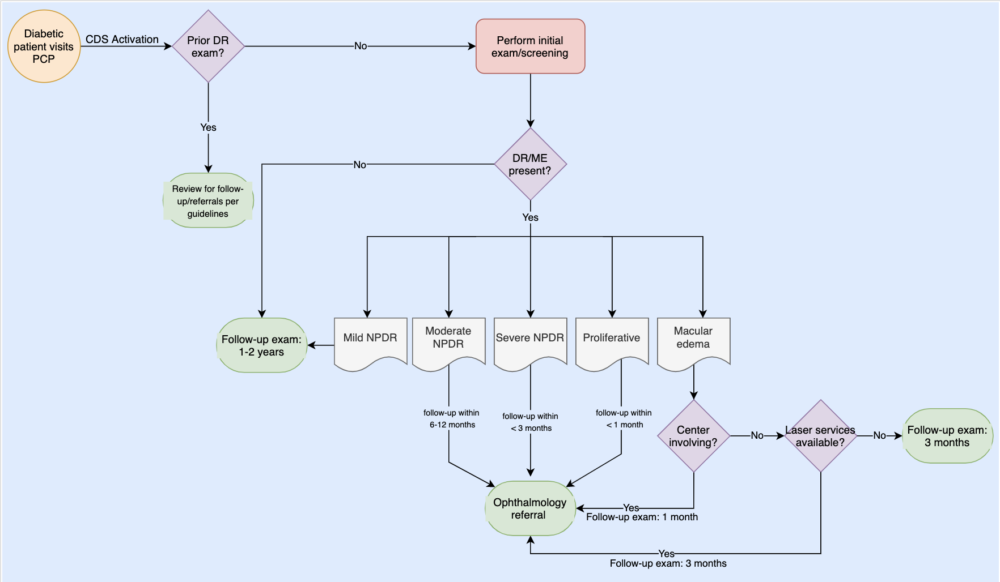
CDS Implementation: Low-Intermediate Resource Settings

Slide 51
CDS: Education and Rollout
“Training and supportive activities are critical to CDS success, and must be an integral part of CDS implementation” (Byrne et al., n.d., p. 34)
Education on screening and referral guidelines
Ensure understanding on the benefits of early identification of DR
Training on the CDSS itself
Ensure understanding of the application and how to use it
Provide a test environment for hands on training

Slide 52
CDS: Measurements of Success
Assess how often the CDS is utilized
Measurement of screening and follow-up examinations
Before and after CDS implementation
Expect an increase in the prevalence of screening and follow-up adherence
Assess for a reduction in the presence/severity of DR within the patient population
Expect a reduction in the severity
Expect a reduction in the overall prevalence
Assess for improved adherence to the American Diabetes Association screening and follow-up guidelines

Slide 53
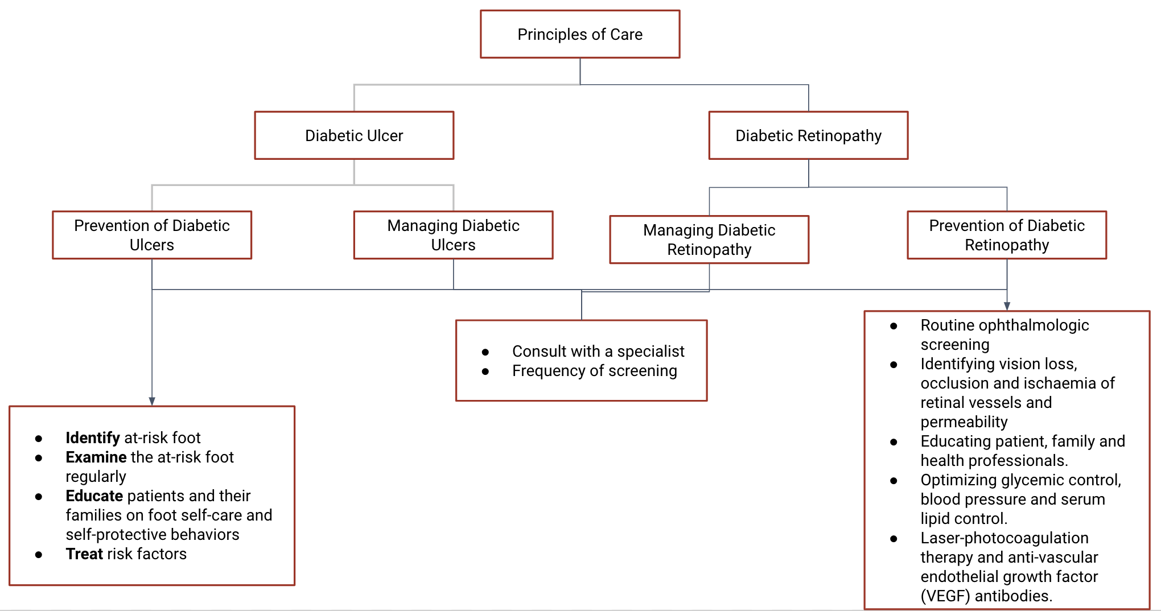
Summary

Slide 54
Challenges and limitations of of Integrating CDS with Routine Care for Diabetic Complications
Educational: Lack of provider awareness and insufficient or lack of education
Clinical: Biological heterogeneity of patients complicates treatment
Technical: insufficient technologies, limited research or lack of large comprehensive databases
Social: unaffordable to many and this may result in care disparities

Slide 55
Recommendations
The CDS framework must fit well with current clinical models
The effectiveness of CDS interventions should be assessed
Feedback obtained from end-users
Error reports
Reported complications or adverse effects
Impact on clinical workflow dynamic
Overall efficiency and usability

Slide 56
Conclusions & Future Directions
Diabetes is a disease with worldwide prevalence and severe complications that are preventable
Implementation of a CDS for both DFU and DR can help to reduce these preventable complications and reduce healthcare disparities
Future Directions:
DFU: Home-based monitoring systems that can identify preulcerative inflammation and alert patients and physicians in advance of the exacerbation of the complication
DR: CDS for treatment in patients with existing DR/ME and screening in pregnancy or pregnancy planning

Slide 57
References
American International Medical University. (2017). Diabetic Retinopathy: Symptoms, Diagnosis, and Management. https://www.aimu.us/2017/02/15/diabetic-retinopathy-symptoms- diagnosis-and-management/.
Barsegian, A., Kotlyar, B., Lee, J., Salifu, M. O., & McFarlane, S. I. (2017). Diabetic Retinopathy: Focus on Minority Populations. International journal of clinical endocrinology and metabolism, 3(1), 034–45. https://doi.org/10.17352/ijcem.000027
Bommer, C., Sagalova, V., Heesemann, E., Manne-Goehler, J., Atun, R., Bärnighausen, T., Davies, J., & Vollmer, S. (2018). Global Economic Burden of Diabetes in Adults: Projections From 2015 to 2030. Diabetes Care, 41(5), 963–970. doi: 10.2337/dc17-1962.
Cuadros, J. (2020). The Real-World Impact of Artificial Intelligence on Diabetic Retinopathy Screening in Primary Care. Journal of Diabetes Science and Technology, 193229682091428. doi:10.1177/1932296820914287.
Diabetic Retinopathy: Pathogenesis and clinical findings Mild ... | GrepMed. (n.d.). Retrieved December 8, 2020, from https://www.grepmed.com/images/8340/pathophysiology-complications-ophthalmology-retinopathy-diagnosis-diabetic-diabetes.
Gardner, T. W., & Chew, E. Y. (2016). Future opportunities in diabetic retinopathy research. Current opinion in endocrinology, diabetes, and obesity, 23(2), 91–96. https:// doi.org/10.1097/MED.0000000000000238.
Gupta, RajendraP & Kotecha, Megha & Bansal, Piyush. (2013). Frequency of diabetic retinopathy in patients with diabetes mellitus and its correlation with duration of diabetes mellitus. Medical Journal of Dr. D.Y. Patil University. 6. 366. 10.4103/0975-2870.118267.
Frank, R. N. (2004). Diabetic Retinopathy. New England Journal of Medicine, 350(1), 48–58. doi:10.1056/nejmra021678.
Fraser, C. E. & D’Amico, D. J. (2018). Diabetic retinopathy: Classification and clinical features. In D. M. Nathan, J. T. Trobe, & J. E. Mulder (Eds.). UpToDate.
https://www-uptodate-com.treadwell.idm.oclc.org/contents/diabetic-retinopathy-classif ication-and-clinical-features/print?search=diabetic.
Fraser, C. E., D’Amico, D. J., & Shah, A. R. (2019). Diabetic retinopathy: Prevention and treatment. In D. M. Nathan, J. T. Trobe, & J. E. Mulder (Eds.). UpToDate. https://www-uptodate-com.treadwell.idm.oclc.org/
contents/diabetic-retinopathypreventon-andtreatment?search=diabetic%20retinopathy&source=search_result&selectedTitle=2~150&usage_type=default&display_rank=2.
Hunt, N. A., Liu, G. T., & Lavery, L. A. (2011). The economics of limb salvage in diabetes. Plastic and Reconstructive Surgery, 127(SUPPL. 1 S). https://doi.org/10.1097/ PRS.0b013e3181fbe2a6.
Javitt, J. C., Aiello, L. P., Chiang, Y., Ferris, F. L., Canner, J. K., & Greenfield, S. (1994). Preventive Eye Care in People with Diabetes Is Cost-Saving to the Federal Government: Implications for health-care reform. Diabetes Care, 17(8), 909–917. doi: 10.2337/diacare.17.8.909.
Karakaya, M., & Hacisoftaoglu, R. E. (2020). Comparison of smartphone-based retinal imaging systems for diabetic retinopathy detection using deep learning. BMC Bioinformatics, 21(S4). doi:10.1186/s12859-020-03587-2.

Slide 58
References
Low, L., Law, J. P., Hodson, J., McAlpine, R., O'Colmain, U., & MacEwen, C. (2015). Impact of socioeconomic deprivation on the development of diabetic retinopathy: a population-based, cross-sectional and longitudinal study over 12 years. BMJ open, 5(4), e007290. https://doi.org/10.1136/bmjopen-2014-007290.
McCulloch, D. K. (2020). Diabetic retinopathy: Screening. In D. M. Nathan, J. T. Trobe, & J. E. Mulder (Eds.). UpToDate. https://www-uptodatecom.treadwell.idm.oclc.org/contents/diabetic retinopathyscreening?search=diabetic%20retinopathy&source=search_result&selectedTitle=4~150&usage_type=default&display_rank=4.
Ogunyemi, O. & Kermah, D. (2015). Machine Learning Approaches for Detecting Diabetic Retinopathy from Clinical and Public Health Records. AMIA Annual Symposium Proceedings, 2015: 983-990.
Ozawa GY, Bearse MA Jr, Adams AJ. Male-female differences in diabetic retinopathy? Curr Eye Res. 2015 Feb;40(2):234-46. doi: 10.3109/02713683.2014.958500. Epub 2014 Dec 29. PMID: 25545999.
Pengzi Zhang, Jing Lu, Yali Jing, Sunyinyan Tang, Dalong Zhu & Yan Bi (2017) Global epidemiology of diabetic foot ulceration: a systematic review and meta-analysis, Annals of Medicine, 49:2, 106-116, DOI: 10.1080/07853890.2016.1231932.
Packer CF, Ali SA, Manna B. Diabetic Ulcer. [Updated 2020 Oct 25]. In: StatPearls [Internet]. Treasure Island (FL): StatPearls Publishing; 2020 Jan-. Available from: https://www.ncbi.nlm.nih.gov/books/NBK499887/#
Schaper, N. C., van Netten, J. J., Apelqvist, J., Bus, S. A., Hinchliffe, R. J., Lipsky, B. A., IWGDF Editorial Board. (2020). Practical guidelines on the prevention and management of diabetic foot disease (IWGDF 2019 update). Diab Metab Res Rev. doi:10.1002/dmrr.3266.
Sen, C. K., Gordillo, G. M., Roy, S., Kirsner, R., Lambert, L., Hunt, T. K., Gottrup, F., Gurtner, G. C., & Longaker, M. T. (2009). Human skin wounds: a major and snowballing threat to public health and the economy. Wound repair and regeneration : official publication of the Wound Healing Society [and] the European Tissue Repair Society, 17(6), 763–771. https://doi.org/10.1111/j.1524-475X.2009.00543.x
Silva, P. S. (2019). Diabetic retinopathy: Pathogenesis. In D. M. Nathan, J. T. Trobe, & J.E. Mulder (Eds.). UpToDate.
Singh, N., Armstrong, D. G., & Lipsky, B. A. (2005). Preventing foot ulcers in patients with diabetes. In Journal of the American Medical Association (Vol. 293, Issue 2, pp. 217–228). JAMA. https://doi.org/10.1001/jama.293.2.217.
Van Houtum, W. H. (2005). Barriers to the delivery of diabetic foot care. In Lancet (Vol. 366, Issue 9498, pp. 1678–1679). Elsevier. https://doi.org/10.1016/ S0140-6736(05)67675-1.
Wong, T. Y., Sun, J., Kawasaki, R., Ruamviboonsuk, P., Gupta, N., Lansingh, V. C., Maia, M., Mathenge, W., Moreker, S., Muqit, M. M. K., Resnikoff, S., Verdaguer, J., Zhao, P., Ferris, F., Aiello, L. P., & Taylor, H. R. (2018). Guidelines on Diabetic Eye Care The International Council of Ophthalmology Recommendations for Screening, Follow-up, Referral, and Treatment Based on Resource Settings. Ophthalmology, 125, 1608–1622. https://doi.org/10.1016/j.ophtha.2018.04.007
World Health Organization. (2020, June 8). “Diabetes.” https://www.who.int/news-room/fact- sheets/detail/diabetes.

